Slide 1
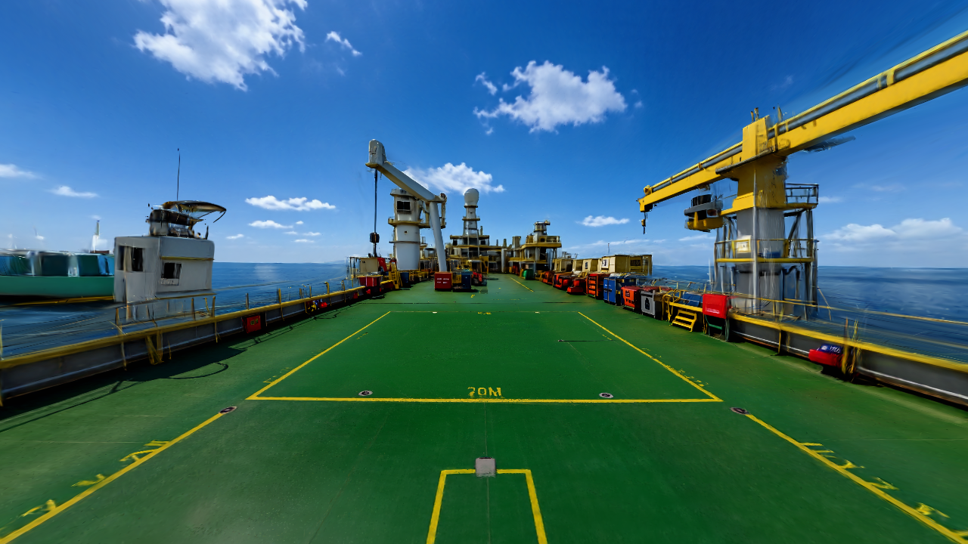
EON WORLDS
PRODUCT AND USE CASES
01
EON Worlds
Serious games inside places that teach.
Product · live Guide ↗ · 56 use cases · 10 first worlds
EON Worlds · 27 September 2026
Notes:
Product concept and preview status; not a claim of a completed one-word-to-published-world workflow.

Slide 2
EON WORLDS
WHY
02
Why practice inside a place?
Small clues become easier to understand when the learner sees their surroundings.
≈900
$2.99T
fatal occupational accidents per day worldwide
2017 ILO estimate of annual safety and health costs
These figures describe the global problem. They do not measure EON Worlds’ impact.
EON Worlds · 27 September 2026
ILO 2023 and 2017
Notes:
https://www.ilo.org/resource/news/nearly-3-million-people-die-work-related-accidents-and-diseases
https://www.ilo.org/resource/news/ilo-head-calls-global-coalition-safety-and-health-work
330,000 / 365 ≈ 904 accident deaths/day.

Slide 3
EON WORLDS
THE PRODUCT
03
One place. Three ways to learn.
SHOW ME
FIND ME
CHALLENGE ME
Watch a guided story. See the clue and why it matters.
Search with help and clear feedback.
Decide independently and see the result.
EON Worlds · 27 September 2026
Notes:
Live example: https://eon-worlds-demo.vercel.app/demo?world=refinery&mission=hazards&mode=showMe

Slide 4
EON WORLDS
USER GUIDE
04
The author answers six simple questions
The complete system adds placement, expert review, and publishing after the plan.
1 Place
2 Look
3 Lesson
What environment?
What should it show?
What should be learned?
4 Story
5 World
6 Plan
What clues and answers?
Reuse or generate?
Save and hand off.
EON Worlds · 27 September 2026
Notes:
Creator preview: https://eon-worlds-demo.vercel.app/create
Production generation and publishing are not yet available in the public creator.

Slide 5
EON WORLDS
AVAILABILITY
05
What is real today and what is planned
PREVIEW NOW
STILL TO BUILD
Live refinery and offshore examples
Guided mission and practice
Six-question creator planner
Local draft and JSON export
Public world import and publish
Precise clue and route authoring
Expert sign-off workflow
Shared storage and publishing
EON Worlds · 27 September 2026
Notes:
Source: docs/WORLD_CREATOR_BUILD_STATUS_2026-09-23.md.

Slide 6
EON WORLDS
56 USE CASES
06
Oil and gas
Eight candidate missions · each needs local expert review.
01
LNG cargo deck: spot a hose crossing the marked route
05
Refinery pump: identify a loose guard before handback
02
LNG manifold: distinguish a wet trace from a dry joint
06
Offshore platform: choose a safe route to a muster point
03
LNG deck: notice a damaged temporary lead near moisture
07
Well pad: identify a high pressure line exclusion area
04
Refinery pump alley: report a small flange seep
08
Storage tank: recognize vapor exposure cues before gauging
EON Worlds · 27 September 2026
Notes:
Illustrative concepts only. Safety wording and source material must be checked for each customer environment.

Slide 7
EON WORLDS
56 USE CASES
07
Marine and ports
Eight candidate missions · each needs local expert review.
09
Mooring deck: find the snap back zone
13
Ballast station: match a valve label to the correct line
10
Gangway: check the access route and handrails
14
Cargo hold: recognize a permit required entry
11
Port crane: keep clear of a suspended load
15
Pilot transfer: inspect the ladder arrangement visually
12
Engine room: notice an unguarded hot surface
16
Shore power: spot a damaged cable on the dock
EON Worlds · 27 September 2026
Notes:
Illustrative concepts only. Safety wording and source material must be checked for each customer environment.

Slide 8
EON WORLDS
56 USE CASES
08
Energy and utilities
Eight candidate missions · each needs local expert review.
17
Substation: identify an arc flash boundary
21
Gas distribution: notice a damaged meter enclosure
18
Wind turbine: check climbing and rescue readiness
22
Power line work: recognize a crossing clearance hazard
19
Solar roof: notice an unprotected edge
23
Hydropower station: follow a controlled access route
20
Battery room: identify ventilation and spill cues
24
Generator room: confirm a maintenance tag is present
EON Worlds · 27 September 2026
Notes:
Illustrative concepts only. Safety wording and source material must be checked for each customer environment.

Slide 9
EON WORLDS
56 USE CASES
09
Manufacturing and chemicals
Eight candidate missions · each needs local expert review.
25
Chemical blending: catch a container label mismatch
29
Forklift charging bay: identify a blocked eyewash
26
Reactor area: find a blocked relief route
30
Hot work area: find combustible material nearby
27
Conveyor line: notice a missing guard
31
Gas cylinder store: notice an unsecured cylinder
28
Robot cell: respect a restricted access boundary
32
Packaging line: compare good and damaged machine guarding
EON Worlds · 27 September 2026
Notes:
Illustrative concepts only. Safety wording and source material must be checked for each customer environment.

Slide 10
EON WORLDS
56 USE CASES
10
Construction and civil works
Eight candidate missions · each needs local expert review.
33
Crane lift: identify people under the load path
37
Concrete pump: find a hose pinch zone
34
Excavation: notice a missing protective system
38
Road work: notice a vehicle blind spot
35
Scaffold: spot an incomplete platform
39
Roof access: choose the protected path
36
Temporary power: identify a damaged extension lead
40
Demolition: recognize visible dust and poor segregation
EON Worlds · 27 September 2026
Notes:
Illustrative concepts only. Safety wording and source material must be checked for each customer environment.

Slide 11
EON WORLDS
56 USE CASES
11
Healthcare and laboratories
Eight candidate missions · each needs local expert review.
41
Isolation room: choose the correct entry preparation
45
MRI suite: screen a metal object before entry
42
Treatment room: find an unsafe sharps container
46
Sterile room: identify a hand hygiene gap
43
Oxygen store: identify an unsecured cylinder
47
Pharmacy: distinguish look alike medication packages
44
Laboratory bench: respond to a small chemical spill
48
Waste room: sort a misplaced clinical waste bag
EON Worlds · 27 September 2026
Notes:
Illustrative concepts only. Safety wording and source material must be checked for each customer environment.

Slide 12
EON WORLDS
56 USE CASES
12
Logistics and public spaces
Eight candidate missions · each needs local expert review.
49
Warehouse aisle: find a forklift pedestrian conflict
53
Rail yard: choose a safe crossing route
50
Loading dock: check trailer restraint status
54
Food plant: spot a sanitation boundary breach
51
Pallet rack: notice a damaged upright
55
Hotel: find a blocked fire exit
52
Airport ramp: find loose objects before pushback
56
School laboratory: identify an unsafe setup before class
EON Worlds · 27 September 2026
Notes:
Illustrative concepts only. Safety wording and source material must be checked for each customer environment.

Slide 13
EON WORLDS
FIRST LIBRARY
13
Ten worlds worth building · 1 to 5
Research starting points; site procedures and world rights are still required.
01
LNG cargo deck
A pre transfer observation round across manifold, walkway, and temporary power areas.
02
Refinery pump alley
A maintenance handback walk through where the learner compares normal and abnormal evidence.
03
Offshore well pad
A route through pumps and high pressure lines before work starts.
04
Electrical substation
A visual pre job check without simulated energized work.
05
Chemical blending skid
A batch preparation decision with a label and valve line up check.
EON Worlds · 27 September 2026
Official guidance linked in speaker notes
Notes:
LNG cargo deck: https://www.imo.org/en/ourwork/safety/pages/igc-code.aspx
Refinery pump alley: https://www.osha.gov/process-safety-management
Offshore well pad: https://www.osha.gov/oil-and-gas-extraction/hazards
Electrical substation: https://www.osha.gov/electrical/flash-hazards
Chemical blending skid: https://www.osha.gov/process-safety-management/hazards

Slide 14
EON WORLDS
FIRST LIBRARY
14
Ten worlds worth building · 6 to 10
Research starting points; site procedures and world rights are still required.
06
Crane lift area
A walk around the lift perimeter before the load moves.
07
Confined vessel entry
A stop at the entry point focused on authorization and visible safeguards.
08
Warehouse loading dock
A forklift and pedestrian route decision beside an open dock.
09
Healthcare isolation room
A short preparation and exit practice for a fictional patient room.
10
Wind turbine access
A climb preparation and route inspection at a fictional turbine.
EON Worlds · 27 September 2026
Official guidance linked in speaker notes
Notes:
Crane lift area: https://www.osha.gov/hazfinder/text-version/construction
Confined vessel entry: https://www.osha.gov/sites/default/files/publications/CONFINED_SPACE_PERMIT.pdf
Warehouse loading dock: https://www.osha.gov/powered-industrial-trucks/
Healthcare isolation room: https://www.cdc.gov/infection-control/hcp/basics/standard-precautions.html
Wind turbine access: https://www.osha.gov/green-jobs/wind-energy/falls

Slide 15
EON WORLDS
EON ONE PLATFORM
15
Where EON Worlds can fit
The attached platform slide shows a digital twin and a work loop.
DIGITAL TWIN
WORK LOOP
Captured places and simulated events become worlds where people can rehearse decisions.
In a future integration, approved work controls and field observations could improve the next lesson.
EON Worlds · 27 September 2026
Notes:
Inspiration: user-provided EON One Platform slide v2.pdf. Connections described here are proposed, not verified integrations.

Slide 16
EON WORLDS
NEXT BUILD
16
Build, test, then grow the library
1
Import one real world
2
Place clues in the world
3
Get expert approval
4
Measure learning
5
Publish a versioned lesson
EON Worlds · 27 September 2026
Notes:
A product roadmap, not a commitment that these features are already available.

Slide 17
EON WORLDS
WHAT WORKS
02
A 3D lesson people can actually try
The refinery is a staged training example. It does not describe a real site.
01
02
03
04
WATCH
PRACTICE
DECIDE
CREATE
Narrated Show me mission with visible clues and captions.
Find me gives help and clear right or wrong feedback.
Challenge me asks for an independent answer.
Six easy questions produce an editable lesson plan.
EON Worlds · 27 September 2026
Notes:
Current feature inventory: docs/WORLD_CREATOR_BUILD_STATUS_2026-09-23.md and docs/MISSION_UPGRADE.md.

Slide 18
EON WORLDS
CREATOR PREVIEW
04
One small question at a time
The creator currently makes a plan; it does not yet publish a world.
1
Place
2
Look
3
Lesson
Type “ship” or another simple idea.
Check the world description.
Choose what people will learn.
4
Story
5
World
6
Plan
Edit proposed clues and answers.
Reuse a sample or record a Marble link.
Download or import a JSON draft.
EON Worlds · 27 September 2026
Notes:
Local implementation in src/creator.ts. Public creator may lag this local guide update until Vercel authentication is restored.

Slide 19
EON WORLDS
REMAINING WORK
05
Four gates remain for a complete product
1 · Import
Generate or import a rights-cleared navigable world and verify scale.
2 · Author
Place clues and a scenic route in the actual 3D scene.
3 · Review
Test all modes and get expert approval of safety content.
4 · Publish
Add shared storage, versions, records, and a customer link.
EON Worlds · 27 September 2026
Notes:
At last audit, World Labs API balance was zero. Local owner gateway tested with fake provider. No production generation or arbitrary Marble import has been completed.

Slide 20
EON WORLDS
NEXT MILESTONE
06
Finish one world before making twenty
A credible, reviewed pilot will teach us what the platform needs.
Next build
Pick one scene → import it → place three believable clues → review it with an expert → measure the learner’s decisions.
Live demo: https://eon-worlds-demo.vercel.app/demo?world=refinery&mission=hazards&mode=showMe
EON Worlds · 27 September 2026
Notes:
Product completion is not presented as a numeric percentage because the remaining import, release, and validation work has not been sized reliably.

Slide 21
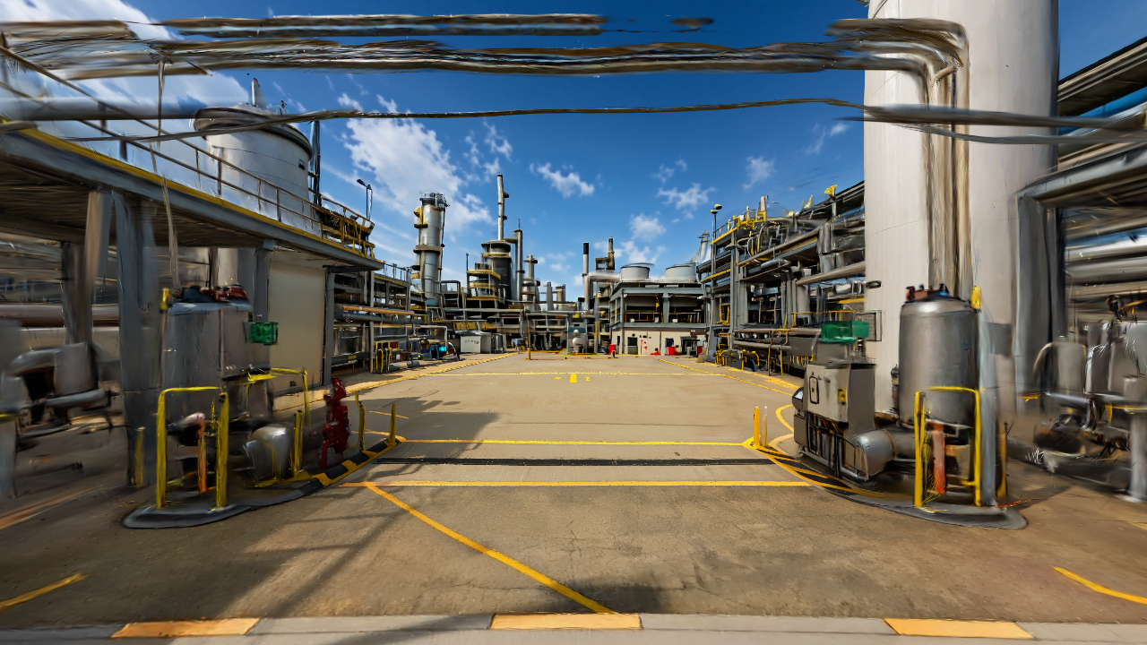
EON WORLDS
LIBRARY STRATEGY
01
EON Worlds
16 libraries from 211 situations
Ten worlds to build first, ranked for a compelling and useful learning experience.
Situation Room catalog review · 27 Sep 2026
Notes:
Pinned reference export: EON-Reality-INC/Situation-Room, commit e1960f66828d24d50eca0d1678f47e41f10c914b, snapshot 2026-08-12T07:34:31Z. Local public-situations.json SHA-256 83e53c5d5e39e26ee7cc3959816a7c5cf0377bd94741627e96a03d69c281f966. Portfolio triage only, not expert safety validation. The image is an existing staged EON Worlds refinery preview.

Slide 22
EON WORLDS
WHAT WE REVIEWED
02
One complete source catalog
The source export contains 211 unique cards, not 210. The final card is a named meta-scenario.
211
16
10
cards mapped
proposed libraries
starter worlds
120 oil & gas 31 aerospace 30 healthcare 30 mining
Situation Room catalog review · 27 Sep 2026
Notes:
Pinned reference export: EON-Reality-INC/Situation-Room, commit e1960f66828d24d50eca0d1678f47e41f10c914b, snapshot 2026-08-12T07:34:31Z. Local public-situations.json SHA-256 83e53c5d5e39e26ee7cc3959816a7c5cf0377bd94741627e96a03d69c281f966. Portfolio triage only, not expert safety validation. Counts computed from source card IDs and vertical fields. Card #211 title: Utility-Failure Cascade into Unit Trip (The Meta-Scenario).

Slide 23
EON WORLDS
PRIORITY LOGIC
03
Why these libraries rank first
A useful world needs a place to explore and a decision the learner can make.
01
Visible evidence
Can the learner spot a clue in the 3D scene?
02
Clear action
Can the lesson reward a safe, observable choice?
03
Reusable world
Can one scene teach several cases?
04
Broad relevance
Does it serve more than one customer or industry?
Situation Room catalog review · 27 Sep 2026
Notes:
Editorial ranking by EON Worlds fit, representative value, visual teaching opportunity and build feasibility. Not a numeric safety-risk ranking. Pinned reference export: EON-Reality-INC/Situation-Room, commit e1960f66828d24d50eca0d1678f47e41f10c914b, snapshot 2026-08-12T07:34:31Z. Local public-situations.json SHA-256 83e53c5d5e39e26ee7cc3959816a7c5cf0377bd94741627e96a03d69c281f966. Portfolio triage only, not expert safety validation.

Slide 24
EON WORLDS
SIXTEEN LIBRARIES
04
Ranked libraries · 1 to 8
First wave: start with places people can inspect.
RANK
LIBRARY
CARDS
01
Leaks fire and gas
15
02
Isolation and maintenance
15
03
Pumps and compressors
15
04
Surface mine traffic
8
05
Mine plant and tailings
11
06
Aircraft maintenance and inspection
13
07
Clinical alarms and infection
8
08
Underground mine response
11
Situation Room catalog review · 27 Sep 2026
Notes:
Pinned reference export: EON-Reality-INC/Situation-Room, commit e1960f66828d24d50eca0d1678f47e41f10c914b, snapshot 2026-08-12T07:34:31Z. Local public-situations.json SHA-256 83e53c5d5e39e26ee7cc3959816a7c5cf0377bd94741627e96a03d69c281f966. Portfolio triage only, not expert safety validation. Each source card belongs to exactly one proposed library. Rankings are editorial and may change after asset and expert review.

Slide 25
EON WORLDS
SIXTEEN LIBRARIES
05
Ranked libraries · 9 to 16
Later wave: add more precise controls and time-based simulation.
RANK
LIBRARY
CARDS
09
Start-up and shutdown
15
10
Pressure and relief
15
11
Medication and infusion
12
12
Process upsets
15
13
Plant utilities
15
14
Aircraft systems and preflight
18
15
Operating room and imaging
10
16
Major process incidents
15
Situation Room catalog review · 27 Sep 2026
Notes:
Pinned reference export: EON-Reality-INC/Situation-Room, commit e1960f66828d24d50eca0d1678f47e41f10c914b, snapshot 2026-08-12T07:34:31Z. Local public-situations.json SHA-256 83e53c5d5e39e26ee7cc3959816a7c5cf0377bd94741627e96a03d69c281f966. Portfolio triage only, not expert safety validation. Each source card belongs to exactly one proposed library. Rankings are editorial and may change after asset and expert review.

Slide 26
EON WORLDS
TEN STARTER WORLDS
06
First five worlds
Each is a proposed lesson pack. The source cards provide story seeds, not approved teaching content.
01
Refinery leak walk
Refinery yard
Visible leak and ignition exposure; world-first
02
Pump maintenance handback
Pump alley
Spatial walk plus precise pump/permit details
03
LNG transfer deck
LNG ship cargo deck
World walk plus transfer-state simulation
04
Mine haul road
Open pit haul route
World-first route and blind-spot decisions
05
Crusher and tailings
Mine processing plant
World-first guards and routes; data for tailings
Situation Room catalog review · 27 Sep 2026
Notes:
Pinned reference export: EON-Reality-INC/Situation-Room, commit e1960f66828d24d50eca0d1678f47e41f10c914b, snapshot 2026-08-12T07:34:31Z. Local public-situations.json SHA-256 83e53c5d5e39e26ee7cc3959816a7c5cf0377bd94741627e96a03d69c281f966. Portfolio triage only, not expert safety validation. Pack source IDs: Refinery leak walk: card_06_01_flange_gasket_weep Flange / Gasket Weep — Detect & Isolate Early, card_06_05_ignition_source_control Ignition-Source Control in a Hazardous Area, card_06_15_bund_spill_management Spill to Secondary Containment / Bund Management
Pump maintenance handback: card_01_04_pump_auto_start_h2s Energy Isolation Missed on a Pump — Toxic Auto-Start, card_04_03_seal_flush_loss Mechanical Seal Failure & Loss of Seal Flush, card_00_01_loto_stored_pressure Stored-Pressure Release During Maintenance (LOTO)
LNG transfer deck: card_02_06_lng_rollover LNG/LPG Rollover Overpressure on Filling, card_06_01_flange_gasket_weep Flange / Gasket Weep — Detect & Isolate Early, card_00_08_thermal_expansion Blocked-In Liquid Thermal Expansion Overpressure
Mine haul road: mn_freq_blind_spot_collision Haul Truck and Light Vehicle Blind-Spot Collision, mn_freq_haul_truck_runaway Haul Truck Runaway on a Downgrade, mn_freq_dump_edge Truck Reverses Over a Dump Edge
Crusher and tailings: mn_freq_conveyor_entanglement Conveyor Entanglement During Operation or Cleaning, mn_world_crusher_blockage Crusher Blockage Cleared While Feed Can Restart, mn_world_tailings_warning Tailings Water-Balance Warning Ignored

Slide 27
EON WORLDS
TEN STARTER WORLDS
07
Next five worlds
Each is a proposed lesson pack. The source cards provide story seeds, not approved teaching content.
06
Underground escape
Mine tunnel junction
World route with timed emergency choices
07
Aircraft hangar inspection
Maintenance hangar
World search plus exact parts and sign-off data
08
Hospital infusion bay
Medication preparation room
Precise device UI and label checking
09
Patient alarm response
Monitored care room
World orientation plus alarm state
10
Plant utility outage
Utility and control yard
Spatial orientation plus systems simulator
Situation Room catalog review · 27 Sep 2026
Notes:
Pinned reference export: EON-Reality-INC/Situation-Room, commit e1960f66828d24d50eca0d1678f47e41f10c914b, snapshot 2026-08-12T07:34:31Z. Local public-situations.json SHA-256 83e53c5d5e39e26ee7cc3959816a7c5cf0377bd94741627e96a03d69c281f966. Portfolio triage only, not expert safety validation. Pack source IDs: Underground escape: mn_world_ventilation_loss Loss of Primary Ventilation, mn_world_ug_vehicle_fire Underground Vehicle Fire and Evacuation, mn_freq_ug_pedestrian_strike LHD or Underground Truck Strikes a Pedestrian
Aircraft hangar inspection: aero_00_01_ba5390_windscreen The Wrong Bolts — Windscreen Blowout at 17,300 Feet, aero_08_03_tools_fod_pattern The Tool You Didn't Count Back In, aero_08_04_rii_duplicate_inspection The Second Pair of Eyes That Never Looked
Hospital infusion bay: hc_inf_wrong_rate_smartpump The Pump That Delivered Ten Times the Dose, hc_inf_wrong_units_keypad Milligrams, Micrograms, Millilitres — One Keypad, hc_inf_free_flow The Clamp That Wasn't Closed
Patient alarm response: hc_mon_alarm_fatigue_telemetry The Alarm Nobody Answered, hc_air_ventilator_alarm_miss The Breath That Stopped and the Alarm That Didn't Reach, hc_mon_alarm_paused Two Minutes of Silence That Never Ended
Plant utility outage: card_07_06_total_power_blackout Total Electrical Power Failure / Blackout, card_07_08_backup_power_loss Loss of Backup Power (UPS / DC / Emergency Generator), card_07_15_utility_cascade Utility-Failure Cascade into Unit Trip (The Meta-Scenario)

Slide 28
EON WORLDS
WHAT KIND OF LESSON
08
Use the 3D world where it helps
Some situations need exact device behavior or changing process data.
35
World first
Walk, spot visible evidence, explain a safe response.
66
Hybrid
Explore the place, then inspect a precise object or control.
110
Simulation led
Use the place for context, then model hidden or changing states.
Situation Room catalog review · 27 Sep 2026
Notes:
Fit classifications are editorial tags assigned in the audit CSV. They do not indicate scenario quality or readiness. Pinned reference export: EON-Reality-INC/Situation-Room, commit e1960f66828d24d50eca0d1678f47e41f10c914b, snapshot 2026-08-12T07:34:31Z. Local public-situations.json SHA-256 83e53c5d5e39e26ee7cc3959816a7c5cf0377bd94741627e96a03d69c281f966. Portfolio triage only, not expert safety validation.

Slide 29
EON WORLDS
FIRST PILOT
09
Refinery leak walk
A learner crosses the yard, notices a subtle trace, and decides what to report.
Build this first
Use the existing refinery world as context. Place three believable clues at a comfortable viewing distance. Keep the walk route open and the scene visually clear.
Show me → Find me → Challenge me
Situation Room catalog review · 27 Sep 2026
Notes:
Proposed pilot uses Situation Room card IDs card_06_01_flange_gasket_weep, card_06_05_ignition_source_control, card_06_15_bund_spill_management. Existing refinery demo is a staged prototype. New lesson pack is not published. Pinned reference export: EON-Reality-INC/Situation-Room, commit e1960f66828d24d50eca0d1678f47e41f10c914b, snapshot 2026-08-12T07:34:31Z. Local public-situations.json SHA-256 83e53c5d5e39e26ee7cc3959816a7c5cf0377bd94741627e96a03d69c281f966. Portfolio triage only, not expert safety validation.

Slide 30
EON WORLDS
BUILD SEQUENCE
10
How the ten worlds become real lessons
The creator should keep the process simple for a nontechnical author.
1
Choose a place
Pick refinery, ship, mine, hangar or hospital.
2
Choose a story
Select a Situation Room card and learning target.
3
Build and mark
Import or generate the world; place visible clues.
4
Review and test
An expert checks the answer; learners try the mission.
5
Publish
Save a versioned lesson with rights and source records.
Situation Room catalog review · 27 Sep 2026
Notes:
This is the proposed end-to-end production process. Current public creator remains a planning preview; arbitrary import, full authoring, review and publishing are unfinished.

Slide 31
EON WORLDS
DECISION FOR THE TEAM
11
A practical first release
One reviewed world proves the pattern before we multiply it.
Build now
Refinery leak walk, then pump handback and a mine haul road. These test a world-first lesson, a hybrid lesson, and a second industry.
Team input needed
World asset rights, site-specific procedures, and a safety expert to approve each answer.
Situation Room catalog review · 27 Sep 2026
Notes:
Proposed order, not a statement that these worlds are built. Pinned reference export: EON-Reality-INC/Situation-Room, commit e1960f66828d24d50eca0d1678f47e41f10c914b, snapshot 2026-08-12T07:34:31Z. Local public-situations.json SHA-256 83e53c5d5e39e26ee7cc3959816a7c5cf0377bd94741627e96a03d69c281f966. Portfolio triage only, not expert safety validation.

Slide 32
EON WORLDS
SOURCE AND HANDOVER
12
Every card remains traceable
The spreadsheet appendix lists the source ID, title, library rank and intended EON Worlds fit.
211 / 211 cards mapped
The 16 libraries are a portfolio map. The 10 worlds are a build shortlist. Neither replaces source review, rights clearance, or domain expert approval.
Companion file: Situation_Room_211_Card_EON_Worlds_Audit_2026-09-27.csv
Situation Room catalog review · 27 Sep 2026
Notes:
Pinned reference export: EON-Reality-INC/Situation-Room, commit e1960f66828d24d50eca0d1678f47e41f10c914b, snapshot 2026-08-12T07:34:31Z. Local public-situations.json SHA-256 83e53c5d5e39e26ee7cc3959816a7c5cf0377bd94741627e96a03d69c281f966. Portfolio triage only, not expert safety validation. The reference JSON is a pinned read-only export and not evidence of the current live Situation Room publication catalog.

